Slide 1

An Analysis on Metro Bike Share LA
INFS5710: IT Infrastructure for Business Analytics
W19A – Group 5
Name: Mark Tobing
ID: z5122997
Slides: 2 -5
Name: Yifan Luo
ID: z5434256
Slides:6 - 7
Name: Hitesh Rathi
ID: z5507795
Slides:8-9
Notes:
Good Evening everyone, my name is Mark, this is Yifan/Leal, and Hitesh, and this is our analysis on Metro Bike Share LA.
For this assignment, we decided to divide tasks by large topics. I cover User Behavior, which talks about their preferences in terms of Pass and Bike Types alongside the changes in their behavior due to weather; Leal covers Station Characteristics, and Hitesh covers...
In terms of order of presentation, it will be me, followed by Leal, followed by Hitesh.
Without further ado, let us begin.

Slide 2

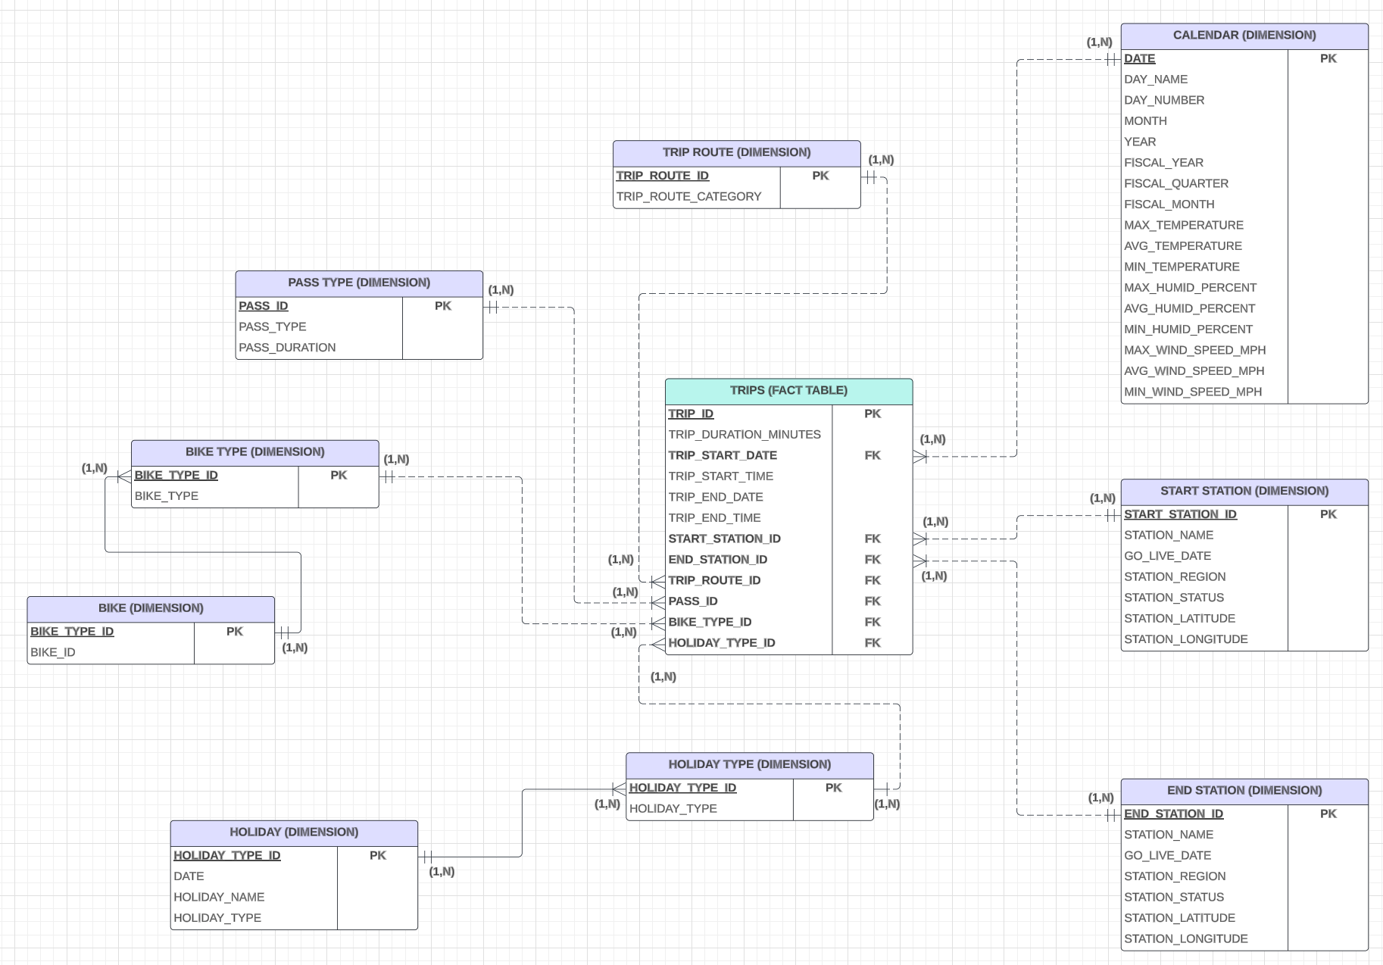

Star / Snowflake Schema
Before making the Star/snowflake we understand the data and its content by
Understanding the company information.
Data Cleaning
Arranging variables according to their Relationships
Making Tables for more easier understandings.
Connecting Tables with different variables from other tables.
Making a Star/Snowflake that is appropriate for our analysis.
2
This slide was written and presented by Mark Tobing (z5122997)

Slide 3

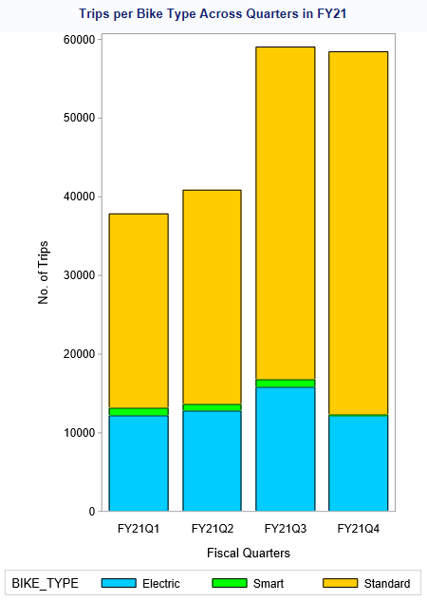
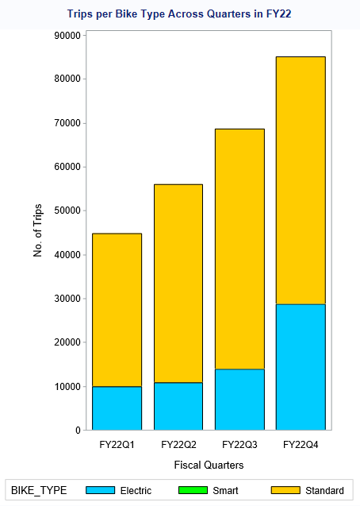
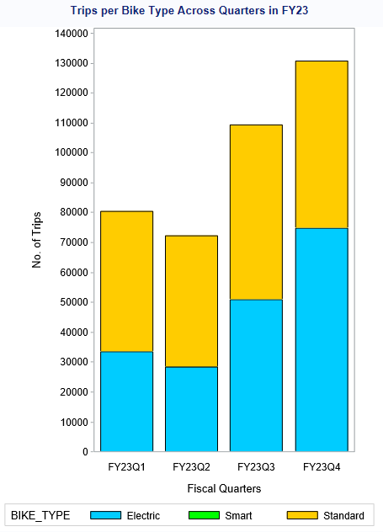
User Behavior | Preferred Bike Types
Electric and Standard Continue to Rule.
Electric Bikes Gaining Popularity.
3
This slide was written and presented by Mark Tobing (z5122997)
Notes:
After examining the above bar charts more closely, a number of insights could be discerned.
It can be seen from the continuous increase in upper limit of the Y-axis and the height of each bar that the number of trips per quarter and per year continues to increase over time.
In addition, it can also be seen that there are bike preferences among users are changing. Firstly, even though there was some demand for Smart Bikes in FY21, it seems that it has lost its appeal amongst users as not a single trip in FY23 had a user use the Smart Bike. Secondly, with no demand for Smart Bikes, users much prefer to engage in trips using either Standard or Electric Bikes instead. As time goes by, each bar only consists of the colors Blue and Yellow, and Green, representing Smart Collars is no more.
And in between Electric and Standard bikes, it seems that Electric Bikes are slowly occupying a larger area in each bar as time goes by. In FY22, about 20 – 30% of all trips used Electric Bikes, but in FY23, at least 35% of all trips, reaching up to nearly 60% of trips in FY23 Q4, used Electric Bikes. This means that an increasing number of riders prefer using the Electric Bikes over Standard Bikes.
There are several reasons behind this trend. Firstly, Electric Bikes have the Electric Pedal-Assist Motor, which facilitates riders to cover greater distances with reduced efforts in comparison to covering the same distance with a Standard Bike. This makes Electric Bikes a more convenient option for travelling great distances in shorter durations with less effort too.

Slide 4

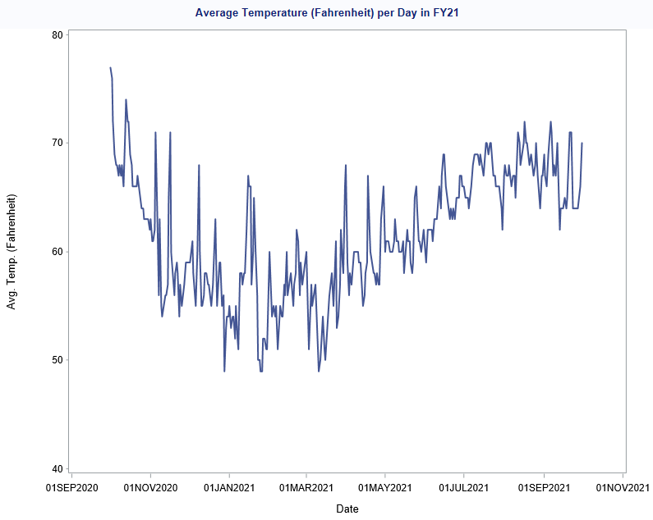
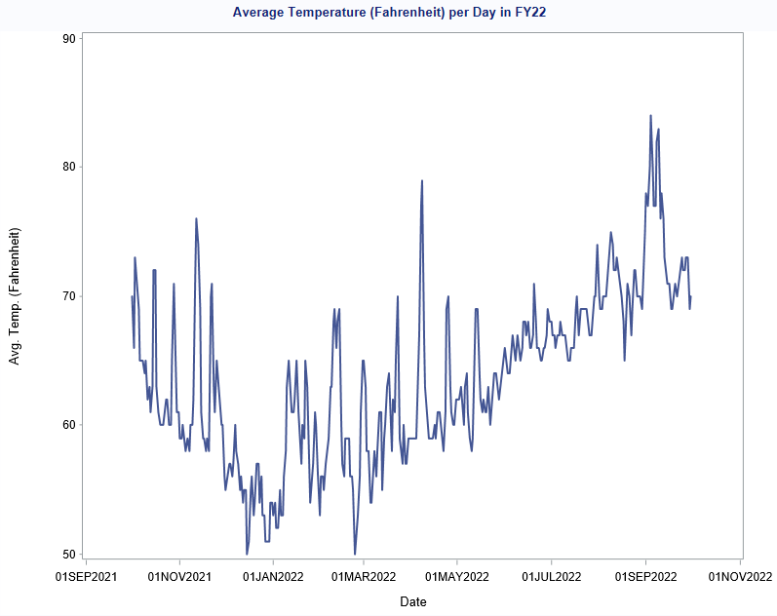
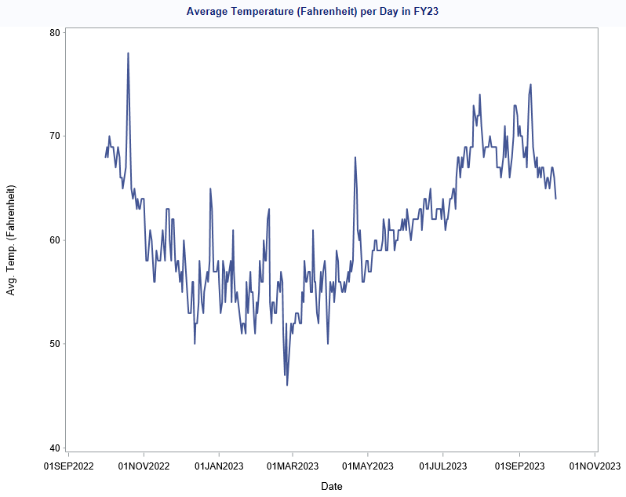
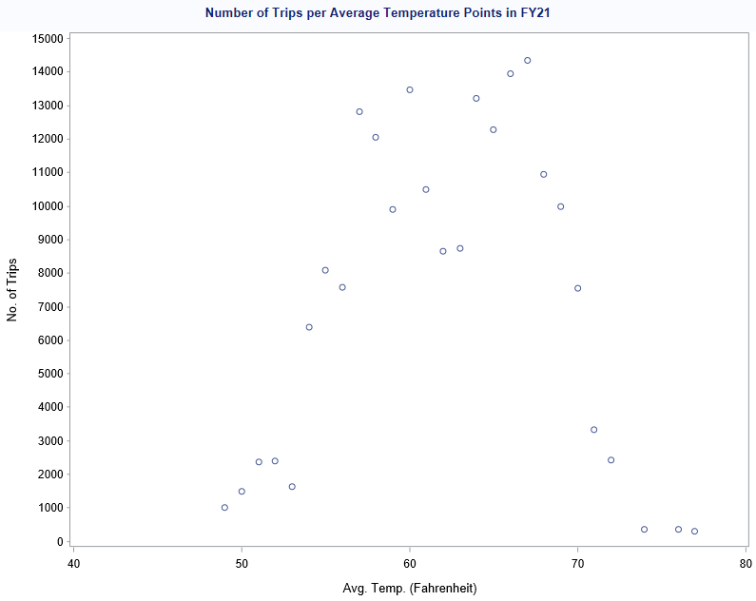
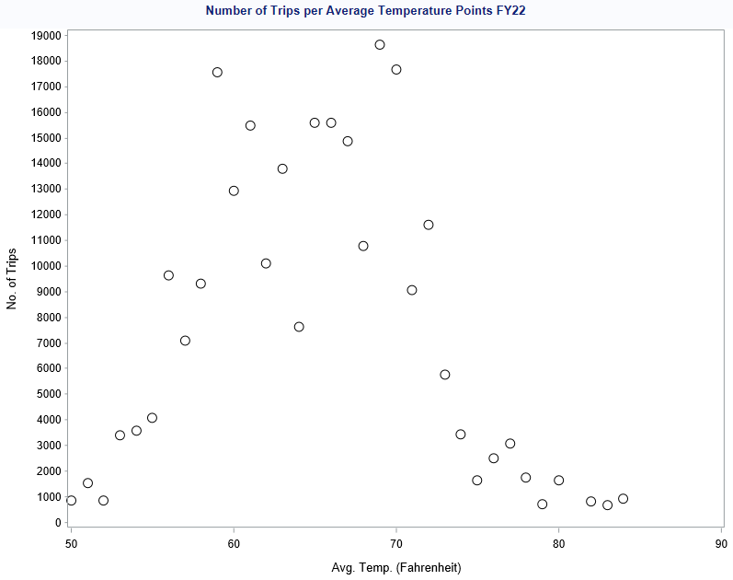
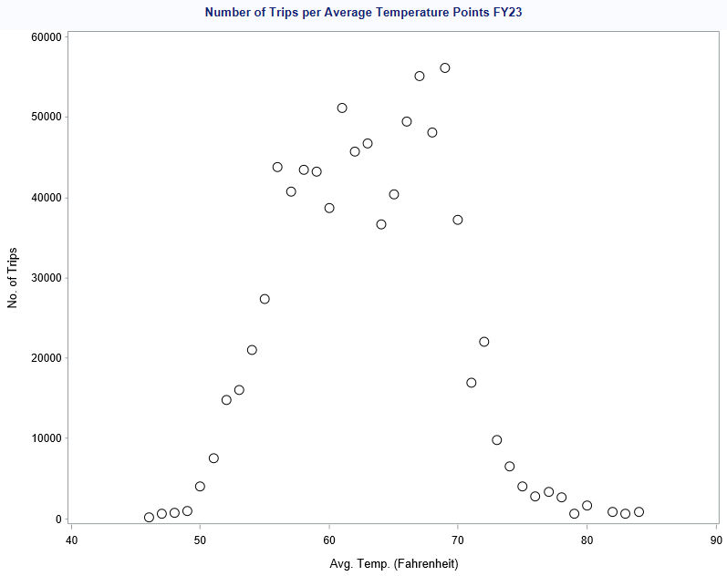
User Behavior | How Does Weather (Temperature) Affect Number of Trips Taken?
4
This slide was written and presented by Mark Tobing (z5122997)
Notes:
The line charts shows the average temperature per day throughout each Financial Year. It can be seen that the temperature warms up starting in the months of March and April, the start of Spring in the USA, and is at their peak during the Summer in the months of June until September. And then it starts getting colder as seasons proceed to go to Autumn, and then Winter from December to February.
The scatter plots underneath them displays the number of trips per different temperature points in each Financial Year. It can be seen that across all of them, most trips occur in temperature ranges 55 – 70 degrees Fahrenheit. But then starts to decline once it gets a bit too cold (below 50) or when it gets too hot (above 80).
This optimal temperature range for biking (58 – 72 degrees Fahrenheit) combined with the trends in how the average temperature changes over the seasons in the USA, provides the insight that bike riding will be most popular from the months of May to about early Summer as it is during this time period that the temperature is within optimal range.

Slide 5
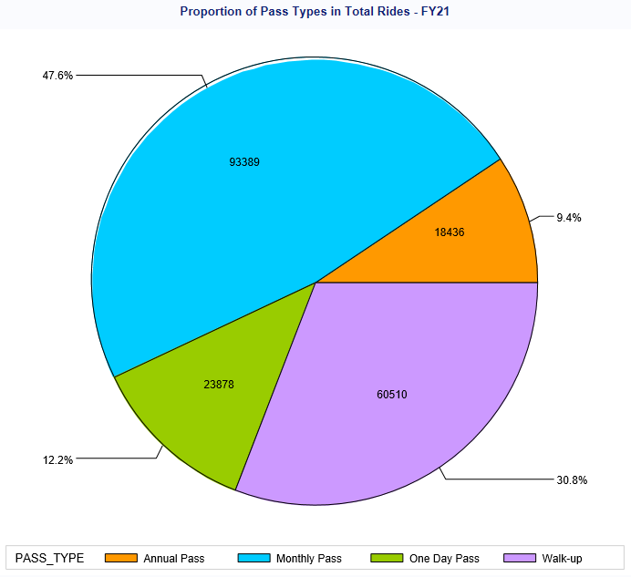
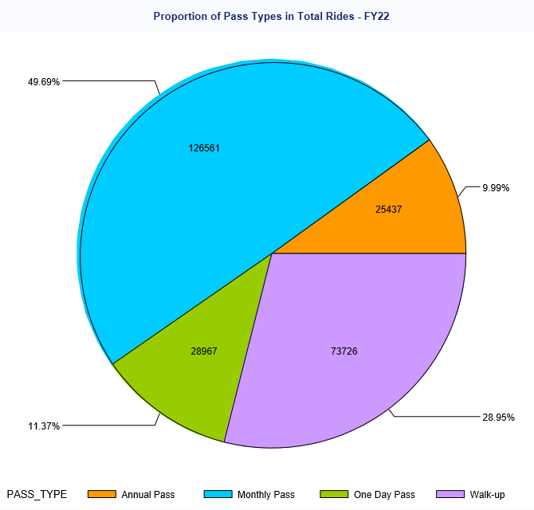
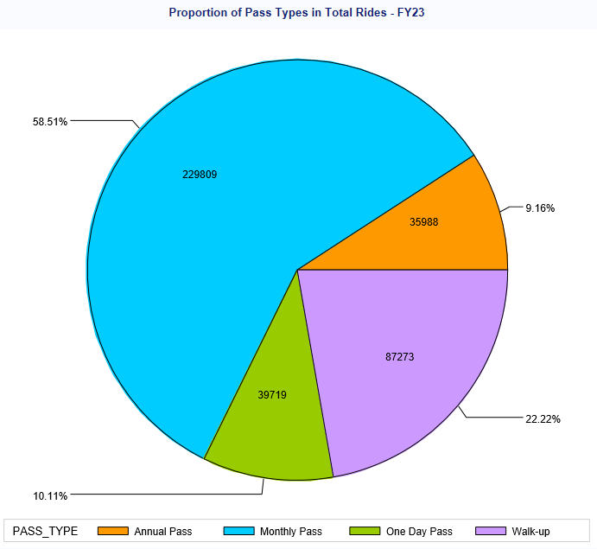
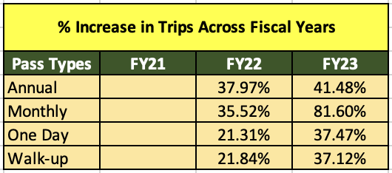
User Behavior | Preferred Pass Types
Monthly Passes Gaining Most Ground.
Huge Increase in FY23. Nearly doubled in amounts of trips taken by Monthly Pass holders.
Peace of Mind. Less worry about having to pay every single time they bike.
Flexibility. Less commitment compared to Annual Passes.
5
This slide was written and presented by Mark Tobing (z5122997)
Notes:
Monthly Passes are becoming increasingly popular amongst riders over the years. In FY23, the number of trips registered with Monthly Pass users increased by 80%, significantly larger than the relatively impressive increase of 42% displayed by the Annual Pass type.
From FY21 – FY23, the number of trips of users using Monthly Passes are increasing on an average of 73% per Fiscal Year, followed by Annual Passes at 48%, One Day at 33%, and Walk-ups at 22%.
From the Pie Charts above, it can be seen that Monthly Passes pie slice continues to get larger over time. It went from representing nearly 50% of all trips in FY21 to nearly 60% in FY23. This shows that more riders are becoming more committed to using Metro Bikes to commute more often but not to a point where they are willing to commit on Annual Passes.
There are several reasons for this. Firstly, by purchasing a monthly pass, in comparison to a One Day or Walk-up, riders will not have to worry about paying every time they pick up a bike from one of the stations. Secondly, compared to annual passes, monthly passes have more flexibility, as the latter locks them into a one-year contract, whereas the prior allows riders to cancel per month, providing an edge in terms of flexibility, just in case they no longer bike or perhaps need to move to a different area.
Our recommendation is to create a loyalty program for Monthly and Annual Pass holders where perks such as discounts on specific days or partner brands are rewarded for their continued subscription.

Slide 6

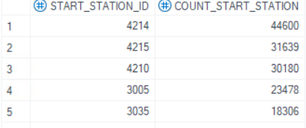
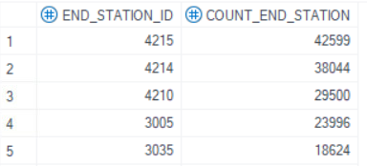
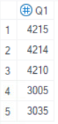
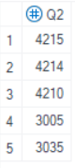
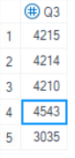
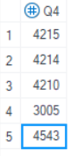
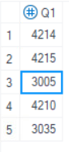
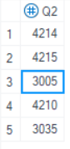
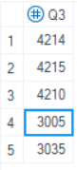
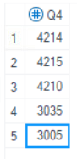
Station Characteristics – Stations (Yifan Luo)
The three most popular station（almost In every year/quarter） are 4210, 4214 and 4215, all located at the same beach attraction.
4543 is also located in a beach attraction. In FY22, because of the popularity of beach attraction April1 to October 9, 4543 increased in Q3 and Q4.
In FY 2023, we found that the demand for 3005 decreased gradually with the change of quarter, and 3005 was located near the large subway transfer station.
FY22 Quarter variation
(no difference between Start station and End station)
FY23 Start station Quarter variation
6
This slide was written and presented by Yifan Luo (z5434256)
Notes:
We found out which station are the most popular. We analyzed the ranking changes of start station and end station every year and quarter. Generally speaking, 4210, 4214 and 4215 are the three most popular stations, which are close to each other and located near the beach. At the same time, we also found some subtle changes in each year. For example, in FY22, the demand for 4543 increased during Q3 to Q4, and 4543 was located near a beach, so the popularity of beach attractions in Q3 and Q4 increased the demand for 4543. In FY23 of Financial, the demand for 3005 gradually decreased with the change of quarter. 3005 was located in a large metro transfer station, and the change of 3005 was related to the Metro passenger flow.
You can find these in Yifan Luo's SQL file:/** total count**/ /* TOTAL TABLE ABOUT END FY22TOP5 */ * TOTAL TABLE ABOUT sta FY23TOP5 */

Slide 7
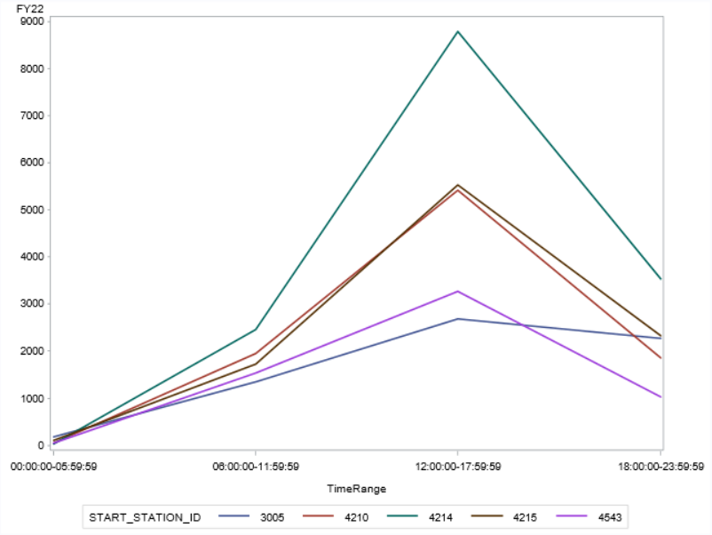
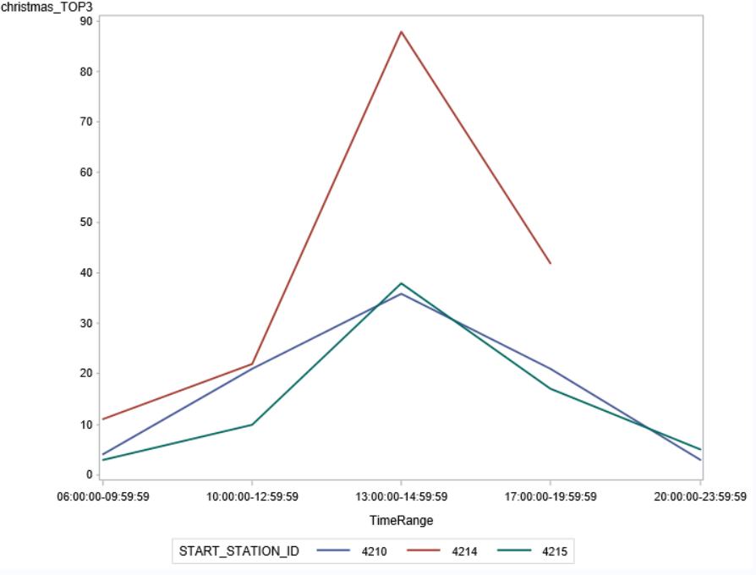
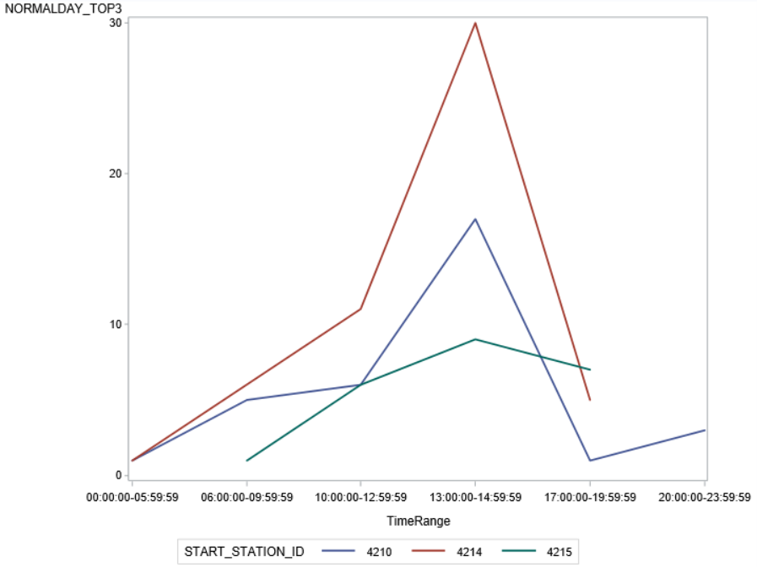
Station Characteristics – Stations (Yifan Luo)
FY22 STA station
FY22 Christmas
No matter every year or every quarter, the peak period is concentrated at noon and afternoon.
In order to better study TOP3stations, we refined the time and found that the peak hours are concentrated from 1 pm to 3 pm, whether it is normal or holidays. The number of users in the peak period can reach three times as much as usual.
FY22
Normal Day
7
This slide was written and presented by Yifan Luo (z5434256)
Notes:
We also analyzed the change of demand and time, and we have the relationship between demand and time of start station and end station in every Financial yea and every quarter. Because there are too many, we only choose the pictures of TOP5 start station in Financial year 2022 to show here, because after our analysis, we find that the relationship is similar every year or even every quarter, and the peak period is basically concentrated from noon to afternoon. At the same time, in order to better analyze the three most popular station, we divide the time interval into more details and try to explore the relationship between holiday and normal day. We analyzed Christmas day and normal day respectively, and we can see that the peak hours are basically the same, but the number of people is quite different, and the demand for holiday may be three times as high as usual.These data can better help the company to prepare enough Bikes in advance to meet customer needs, such as transporting Bikes from some unpopular stations to popular stations.
You can find these in my SQL file:/* fy22 TOP5 start_station TIME */ /**TOP3 STATION HOLIDAYTIME ANALY*//**TOP3 STATION NORMAL ANALY*/

Slide 8
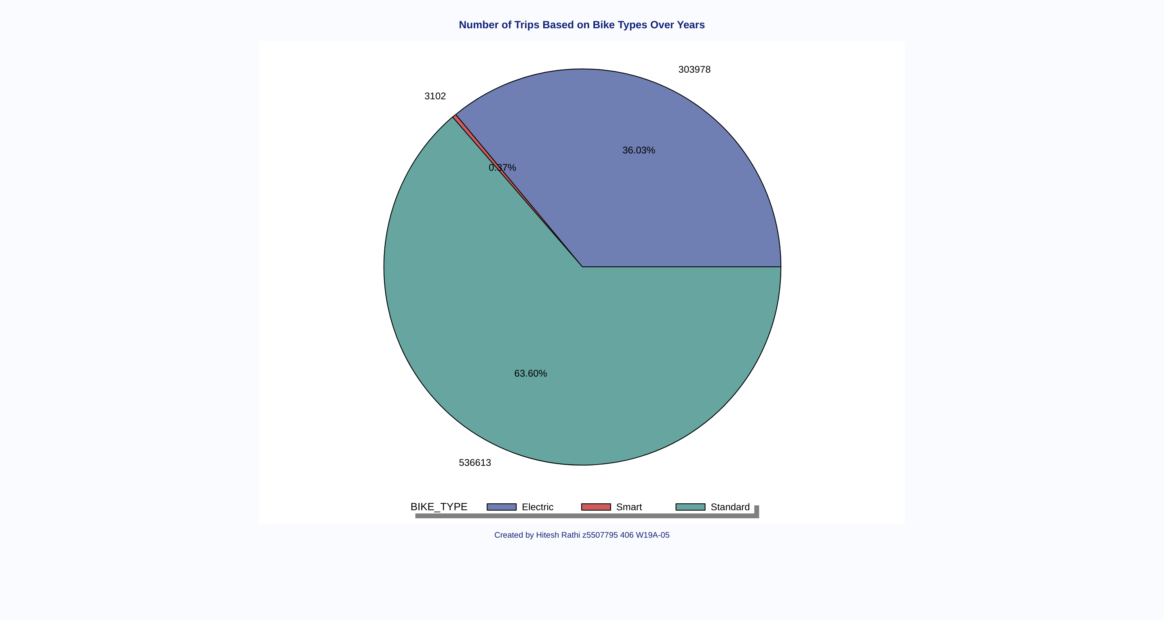
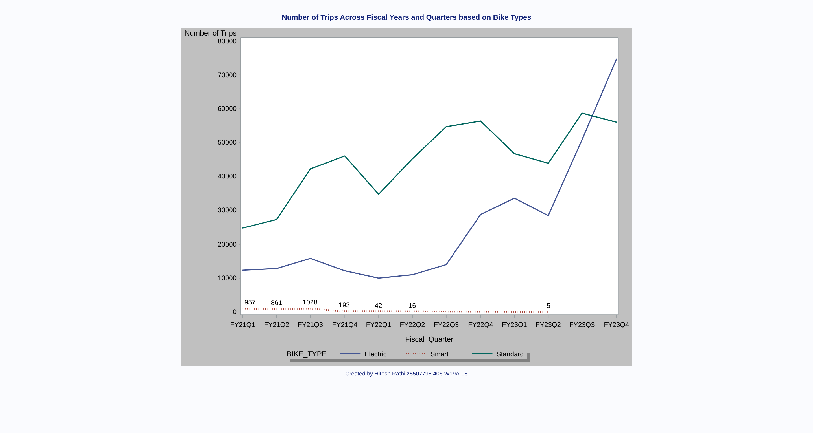
Bike Type Analysis (Hitesh Rathi)
8
This slide was written and presented by Hitesh Rathi
Notes:
For Bike Analysis
We firstly made above pie chart using variables Trip Counts and Bike Type(Group by) over the years.
/**Number of Trips Based on Bike Types Over Years**/
Looking at this we can see that number of trips using smart bike trips are very less compare to the other two.
Number of Trips using smart Metro Bike is around 0.37% (3102) of Total Trips over the years while the other two have 63.60% and 36.03% respectively.
Looking over the next Line Chart, it indicates the Number of Trips Across the years FY21-FY23 by quarter based on the Bike Types.
/**Number of Trips Across Fiscal Years and Quarters based on Bike Types**/
Green Line represent Standard Bikes, Blue Line represent Electric Bikes and the Red Line represent Smart Bikes.
IF you look carefully, trips using smart bikes were highest in FY21Q3(April-June) but then it decreases over the next years.
For FY22Q3-FYQ23Q1, there were no trips made using Smart Bikes and only 5 trips in FY23Q2(Jan-Mar).
After this, the smart bikes trip count is 0 till the end of the FY23.

Slide 9

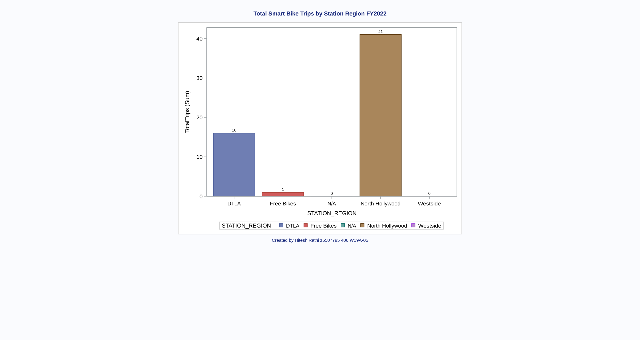
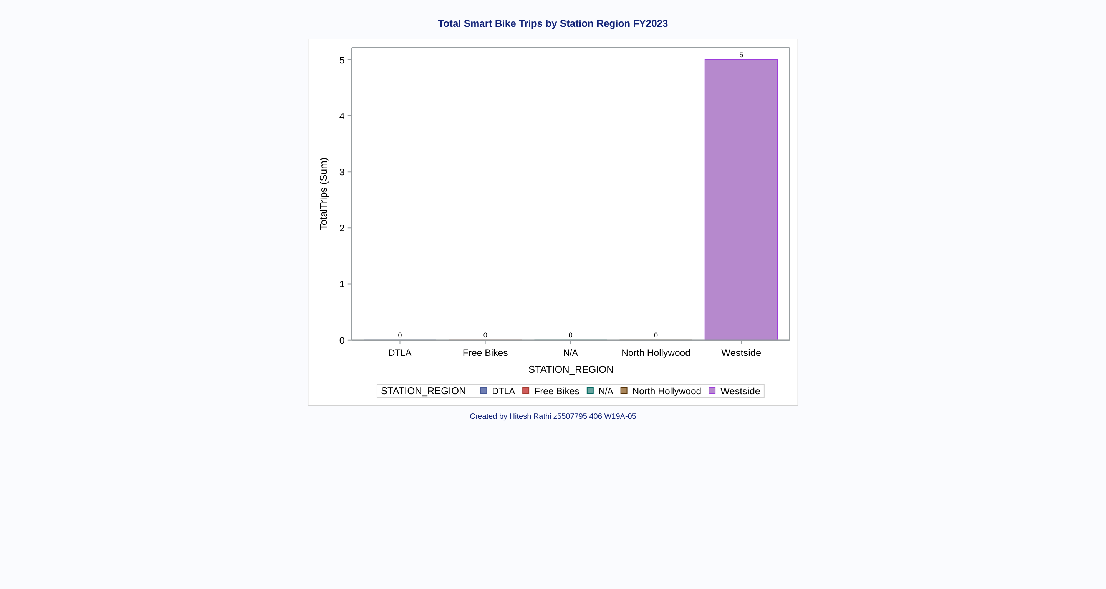
Bike Type Analysis (Hitesh Rathi)
Comparing the use of Smart Metro Bikes in different regions in FY22 and FY23.
9
This slide was written and presented by Hitesh Rathi
Notes:
After Analyzing the usage of different Bikes and in different times.
To further analyze the Smart Metro Bikes, we made two bar graphs that represents the Total Smart bikes Trips based on Station Regions in the year FY22 and FY23 by using variable Trips Counts, Bike Type and Station Region.
In the First Bar Chart, You can see that the usage of Smart Metro Bikes are high in North Hollywood and then 2nd highest in Downtown LA but there are no Trips made in Westside in FY22.
/* Number of Smart Bike Trips Based on Stations Region in FY2022 */
But, In the 2nd Bar Chart, There were no trips made using Smart Metro Bike in different regions except Westside.
The another Key Insights Is that only 5 trips are made in the Westside.
/* Number of Smart Bike Trips Based on Stations Region in FY2023 */
As the Smart Metro bikes trips are not performing well like in the last 6 months only 5 trips are made, proper action should be taken to solve this issue.
Smart Bikes are available mainly in North Hollywood(Metro Bike Share Website).
Reasons:
Maybe trips made from North Hollywood were ended in Westside where Smart Bike usage is less.

Slide 10

Recommendations
Bike Type Analysis
Customer Feedback:
Collect customer feedback to understand why the particular bike type is not popular. This could be done through surveys, reviews, or direct communication with users.
Improve the Type:
Launching or adding new version to the smart Bike Type catering the customers wants.
Discontinuation:
Company may have to think about closing the Smart Bikes if its not performing well and focus on the other two.
Station Analysis​
Pay attention to popular stations：​
The company needs to ensure that there are enough bikes at popular stations for customers to use before the rush hour. Companies may need to prepare three times more than usual during holidays.​
Marketing at popular stations:​
Marketing at known popular stations will be paid more attention by potential customers.
Weather Analysis: Metro Bike Share to provide more incentives to bike when temperature ranges are not within optimal range (e.g. peak winter or peak summer).​
​
Pass Type Analysis: create a loyalty program for Monthly and Annual Pass holders where perks include discounts on bike riding on specific days, purchases in partner brands, or accumulate points to then be exchanged for a gift in the form of Metro Bike share merchandise.​
10
This slide was written and presented by Mark Tobing (z5122997) and Hitesh Rathi(z5507795)
Notes:
These are the recommendations that we think would be really beneficial for the company based on our analysis

Slide 11

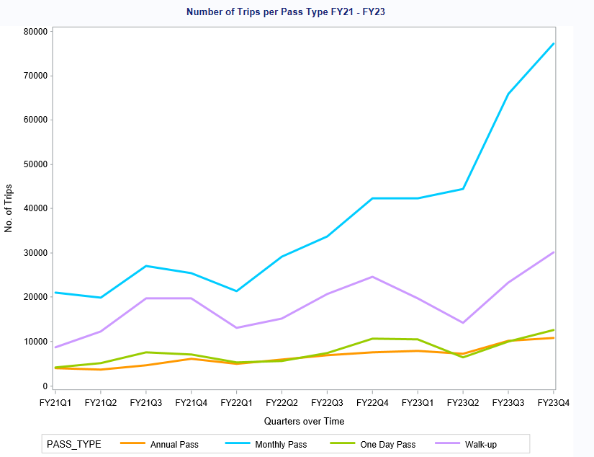
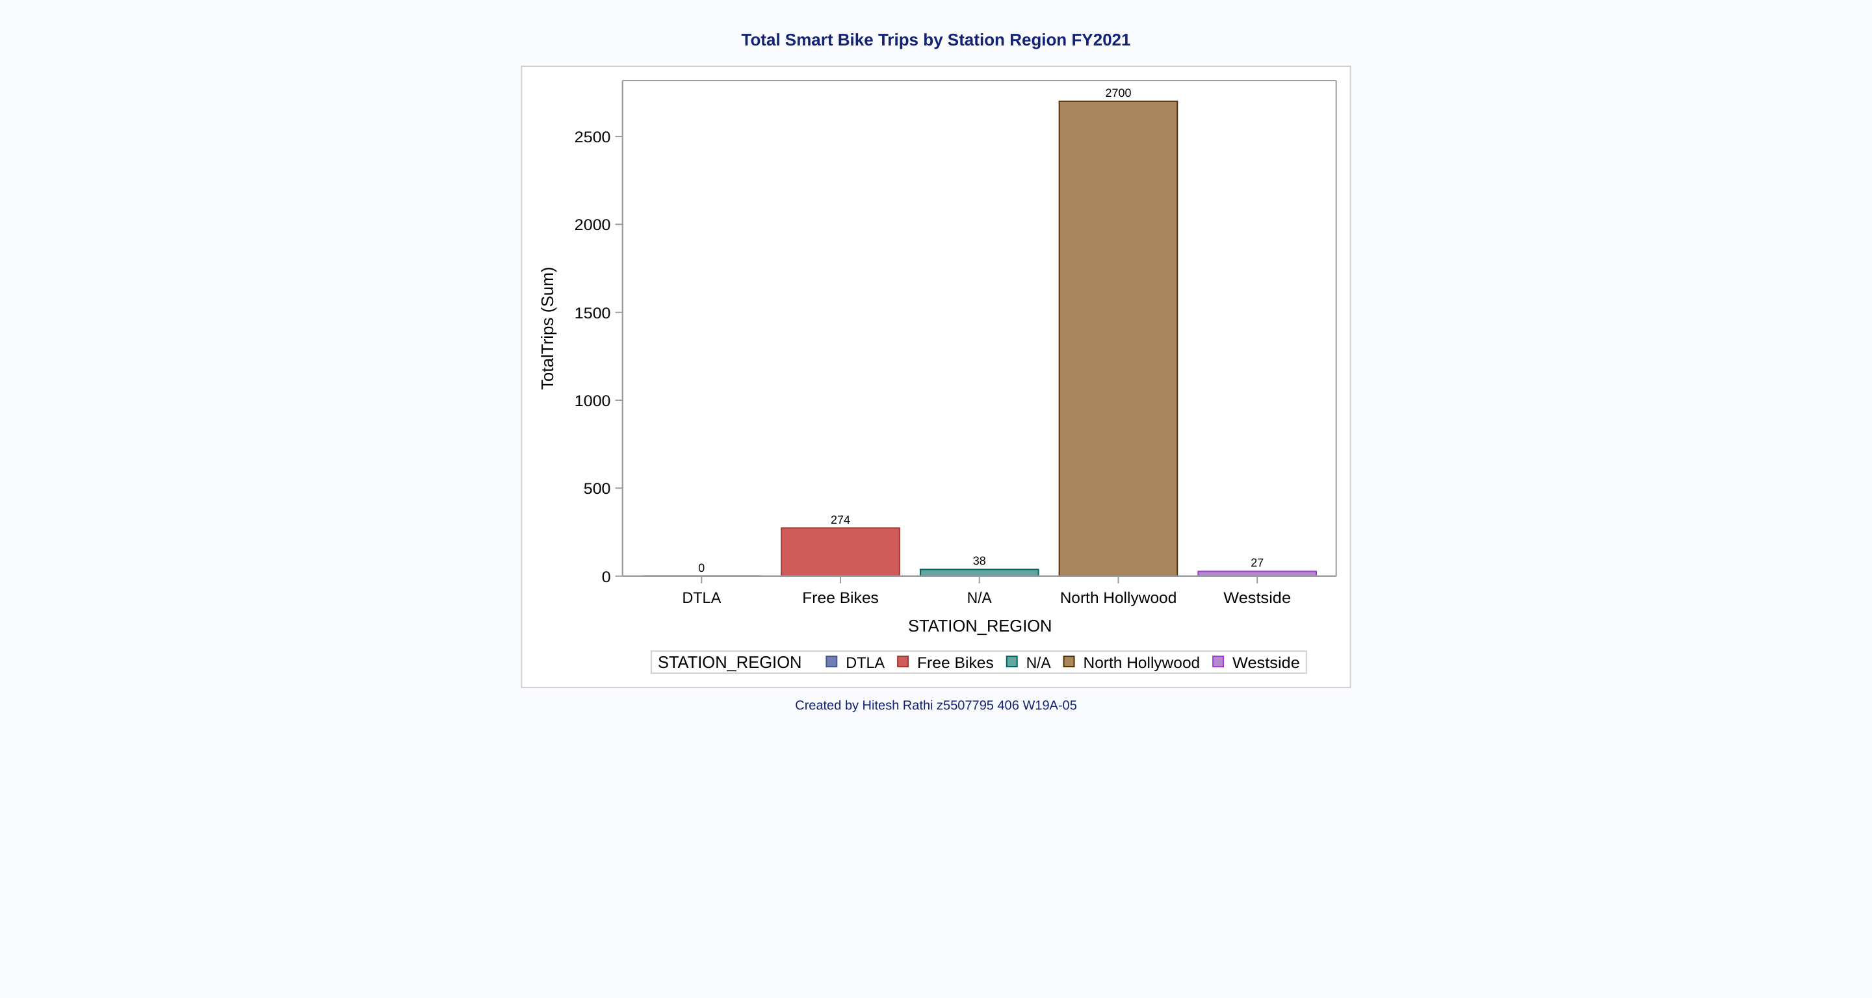
Appendix
11
This slide was written and presented by Mark Tobing (z5122997) and Hitesh Rathi (z5507795)
Notes:
Chart 1: Number of Trips per Pass Type (FY21 – FY23)
Chart 2: Total Smart Bike Trips Made in FY21 among different regions.

